Slide 1
Hazard Detection System
PROJECT BY
JEEVA BHARATHI K
HARISH R

Slide 2
ABSTRACT
Advanced Sensor Deployment: The system employs strategically placed sensors across key areas of oil and gas facilities to detect explosive compounds and volatile gases. These sensors continuously monitor for abnormal patterns indicating potential explosion risks.
﻿
Real-time Monitoring and Analysis: Utilizing real-time monitoring and sophisticated algorithms, the system analyzes data from sensors to promptly identify threats.
﻿
Instant Warning and Safety Measures: Integrated communication technologies ensure instant relay of warnings to nearby workers, enabling timely evacuation if necessary. Redundant sensor arrays and fail-safe mechanisms guarantee continuous operation, enhancing overall safety in hazardous environments.

Slide 3
PROBLEM STATEMENT
To develop a reliable explosion detection system for the oil and gas industries, we propose deploying an advanced sensor network strategically throughout the facility to monitor for explosive compounds and volatile gases.
Real-time monitoring and analysis, supported by sophisticated algorithms and predictive analytics, will enable the system to identify potential threat zones accurately.
Instant warning and communication systems will relay alerts to nearby workers, facilitating prompt evacuation if necessary. Clear emergency response protocols and comprehensive training will ensure an efficient and safe response.

Slide 4

Components:
Esp 32 microcontroller(Wifi module)
MQ2 Gas sensor
Jumper wires

Slide 5
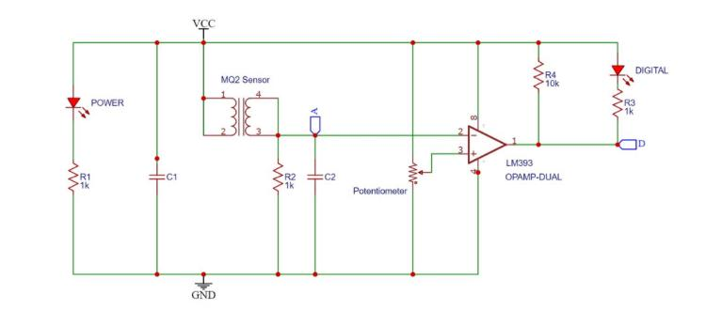
Schematic Diagram:

Slide 6
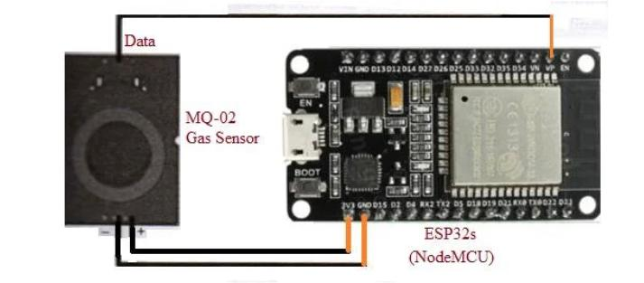
Sample model:

Slide 7
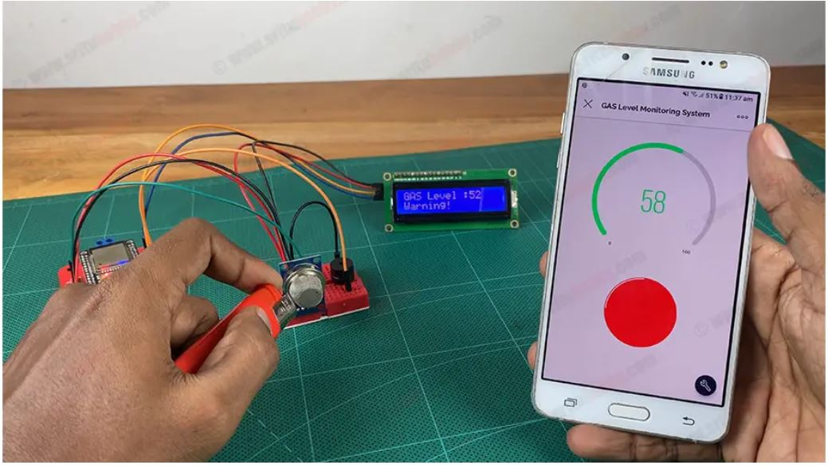
Demo image:

Slide 8
CONCLUSION
In conclusion, by implementing advanced sensor networks and instant warning systems, along with clear emergency response protocols, we can develop a reliable explosion detection system tailored for the oil and gas industries.
This approach aims to enhance safety by effectively identifying potential threat zones and issuing early warnings to nearby workers, thereby mitigating the risk of explosions and safeguarding personnel in hazardous environments.

